Slide 1
User Management

Slide 2
Creating Users
Command = useradd username
Many arguments can be applied.
Set the user’s password using the passwd command.
The password argument in useradd requires the hashed password be supplied.

Slide 3
Creating Users
10 Minutes
Research how to add a system user
Research how to add an Admin user

Slide 4
User Creation
Example 1
useradd -m -d /home/mike1 -s /bin/bash -c "the mike1 user" -U mike1
Explanation:
-m -d /home/mike1 : the -m argument creates the /home/mike1 home directory, specified by the -d argument
-s /bin/bash : the -s is used for specifing the user’s default shell, /bin/bash in this case
-c “message” : extra information about the user

Slide 5
User Creation
Example 2:
useradd -m -d /home/geeks/mike2 -s /bin/zsh -c "the mike2 user" -u 1099 -g 1050 mike2
Explanation:
-m -d /home/geeks/mike2 : the -m argument creates the /home/geeks/mike2 home directory, specified by the -d argument. As you can see, the homedir can be different from /home/user_name
-s /bin/zsh : the -s is used for specifying the user’s default shell, /bin/zsh in the case
-c “the mike2 user” : extra information about the user
-u 1099 : the new user’s UID, in this case 1099
-g 1050 : the user belongs to the group with the 1050 GID

Slide 6
User Creation
Example 3:
$ sudo useradd -m -d /home/mike3 -s /usr/sbin/nologin -c "nologin user" -u 1098 mike3
Explanation:
-m -d /home/mike3 : the -m argument creates the /home/mike3 home directory, specified by the -d argument
-s /usr/sbin/nologin : the -s is used for specifing the user’s default shell, in this case /usr/sbin/nologin . mike3 cannot login to the system with su, but can login by ssh.
-c “nologin user” : extra information about the user
-u 1098 : the new user’s UID, in this case 1098

Slide 7
User Management
Example 4:
$ sudo useradd -m -d /home/mike4 -k /etc/custom.skel -s /bin/tcsh -c "mike4 user" -u 1097 mike4
Explanation:
-m -d /home/mike4 : creates the /home/mike4 home directory
-s /bin/tcsh : the -s is used for specifing the user’s default shell, /bin/tcsh in this case
-k /etc/custom.skel : another skeleton directory, /etc/custom.skell in this case, different than the default skeleton directory /etc/skel
-c “mike4 user” : extra information about the user
-u 1097 : the new user’s UID, in this case 1097

Slide 8
Skeleton Directory
/etc/skel – copied to new user home directory by default
-k option for useradd = specify a different directory to copy into the new home directory
Useful for batch user creation

Slide 9
User Modification
usermod is used to adjust an existing user.
Result in changes to the following files:
/etc/passwd
/etc/security/environ
/etc/security/limits
/etc/security/user
/etc/security/user.roles
/etc/security/audit/config
/etc/group
/etc/security/group
Often used to adjust group membership, user’s shell, etc.

Slide 10
User Deletion
The userdel command modifies the system account files, deleting all entries that refer to login.
userdel –r username
Not often used, can “orphan” files and directories in file system, create issues with automated scripts, etc
Better to disable account and leave it on system

Slide 11
Group Management
groupadd - create a new group
groupadd apache –g 9090 – creates a group with specific gid
groupmod – modify a group
groupmod –n apache apache2 – this will change the group apache to apache2
groupdel - delete a group.
groupdel apache

Slide 12
Admin User
Able to perform admin tasks using the sudo command
/etc/sudoers configuration file
Edit config file using command visudo
Use usermod to add user to necessary group(s)

Slide 13
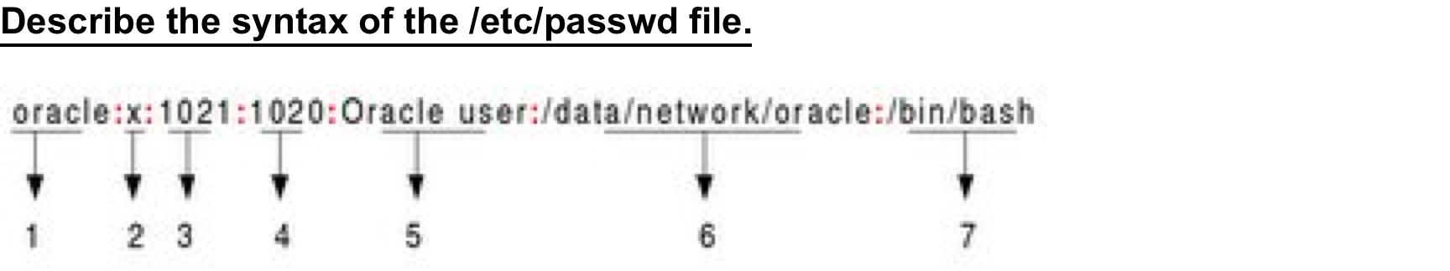
/etc/passwd File

Slide 14
/etc/passwd Fields
Username: It is used when user logs in. It should be between 1 and 32 characters in length.
Password: An x character indicates that encrypted password is stored in /etc/shadow file.
User ID (UID): Each user must be assigned a user ID (UID). UID 0 (zero) is reserved for root and UIDs 1-99 are reserved for other predefined accounts. Further UID 100-999 are reserved by system for administrative and system accounts/groups.
Group ID (GID): The primary group ID (stored in /etc/group file)
User ID Info: The comment field. It allow you to add extra information about the users such as user's full name, phone number etc. This field use by finger command.
Home directory: The absolute path to the directory the user will be in when they log in. If this directory does not exists then users directory becomes /
Command/shell: The absolute path of a command or shell (/bin/bash). Typically, this is a shell. Please note that it does not have to be a shell.

Slide 15
/etc/group File
Describe the syntax of the /etc/group file.
It stores group information or defines the user groups i.e. it defines the groups to which users belong. There is one entry per line, and each line has the following format (all fields are separated by a colon (:)
cdrom:x:24:vivek,student13,raj
__ _ _ _____
| | | |
| | | |
1 2 3 4

Slide 16
/etc/group Fields
Where,
1. group_name: It is the name of group. If you run ls -l command, you will see this name printed in the group field.
2. Password: Generally password is not used, hence it is empty/blank. It can store encrypted password. This is useful to implement privileged groups.
3. Group ID (GID): Each user must be assigned a group ID. You can see this number in your /etc/passwd file.
4. Group List: It is a list of user names of users who are members of the group. The user names, must be separated by commas.

Slide 17

/etc/shadow File
Describ the syntax of /etc/shadow file

Slide 18
/etc/shadow Fields
1. User name : It is your login name
2. Password: It your encrypted password. The password should be minimum 6-8 characters long including special characters/digits
3. Last password change (lastchanged): Days since Jan 1, 1970 that password was last changed
4. Minimum: The minimum number of days required between password changes i.e. the number of days left before the user is allowed to change his/her password
5. Maximum: The maximum number of days the password is valid (after that user is forced to change his/her password)
6. Warn : The number of days before password is to expire that user is warned that his/her password must be changed
7. Inactive : The number of days after password expires that account is disabled
8. Expire : days since Jan 1, 1970 that account is disabled i.e. an absolute date specifying when the login may no longer be used

Slide 19
ACL
How do you add groups or users to directory or file
is it done with the chmod or chown command?
But what would happen you have have 3 users you want to add or even 3 groups would the above commands do the trick?

Slide 20
ACL
To remove all permissions
setfacl –b
To check permissions
getfacl filename
getfacl directoryname

Slide 21
ACL
The way to add multiple groups/users is by using setfacl this will allow for Access Control Lists against files and directories
Add permissions to a user
setfacl -m "u:username:permissions”
Or
setfacl -m "u:uid:permissions”
Add permissions to a group
setfacl -m "g:groupname:permissions”
Or
setfacl -m "g:gid:permissions”

Slide 22
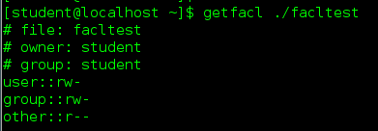
ACLs – Access Control
The way to add multiple groups/users is by using setfacl this will allow for Access Control Lists against files and directories
Add permissions to a user
setfacl -m "u:username:permissions”
Or
setfacl -m "u:uid:permissions”
Add permissions to a group
setfacl -m "g:groupname:permissions”
Or
setfacl -m "g:gid:permissions”

Slide 23
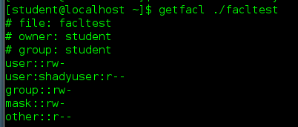
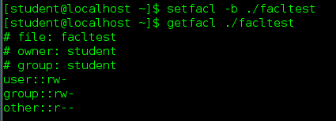
ACLs – Access Control
To remove all permissions
setfacl –b
To check permissions
getfacl filename
getfacl directoryname

Slide 24
Lab 5 Exercise

